Slide 1
EXECUTIVE DASHBOARD

Slide 2
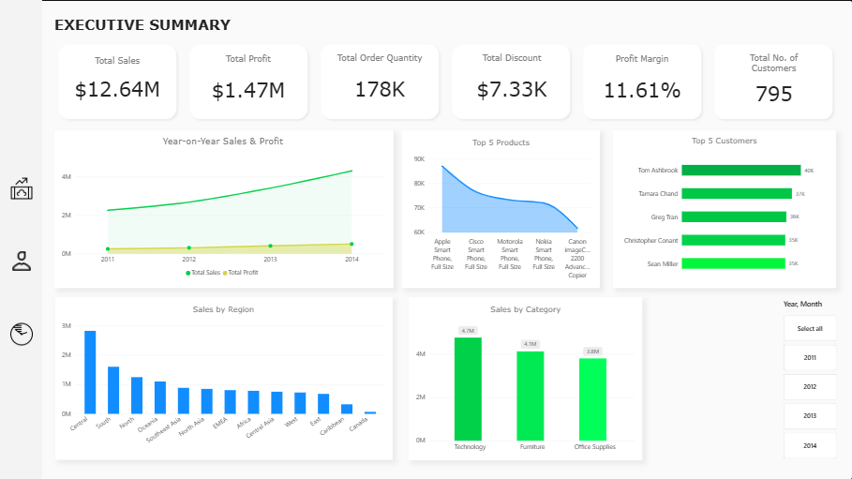

Slide 3
PROFITABILITY
DASHBOARD

Slide 4
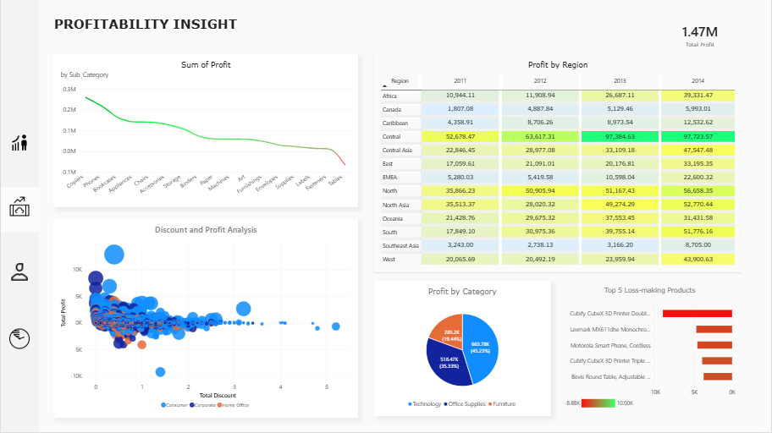

Slide 5
CUSTOMER
DASHBOARD

Slide 6
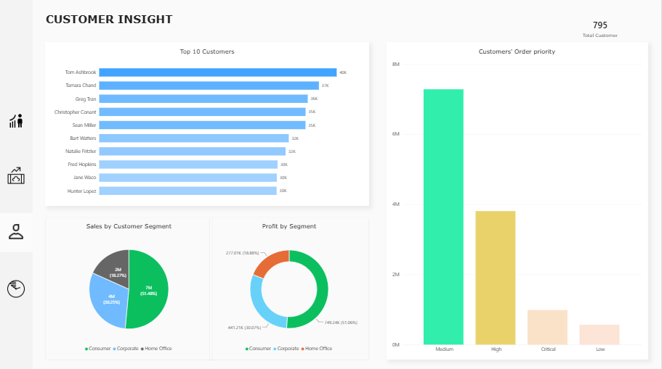

Slide 7
TIME ANALYSIS
TREND

Slide 8
